Slide 1
A core Course on Modeling
Introduction to Modeling
0LAB0 0LBB0 0LCB0 0LDB0
c.w.a.m.v.overveld@tue.nl
v.a.j.borghuis@tue.nl
S.15

Slide 2
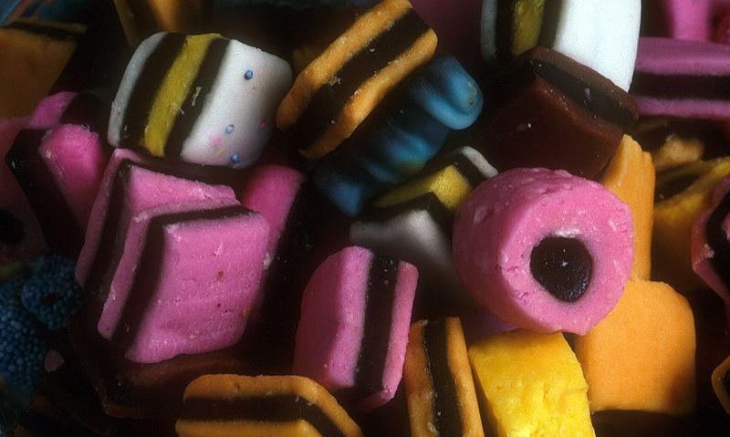
Flavours of time
Transitions happen instantaneous (take no time)
States may last
States and Transitions alternate
http://commons.wikimedia.org/wiki/File:LiquoriceAllsorts2003.jpg
Notes:
2

Slide 3
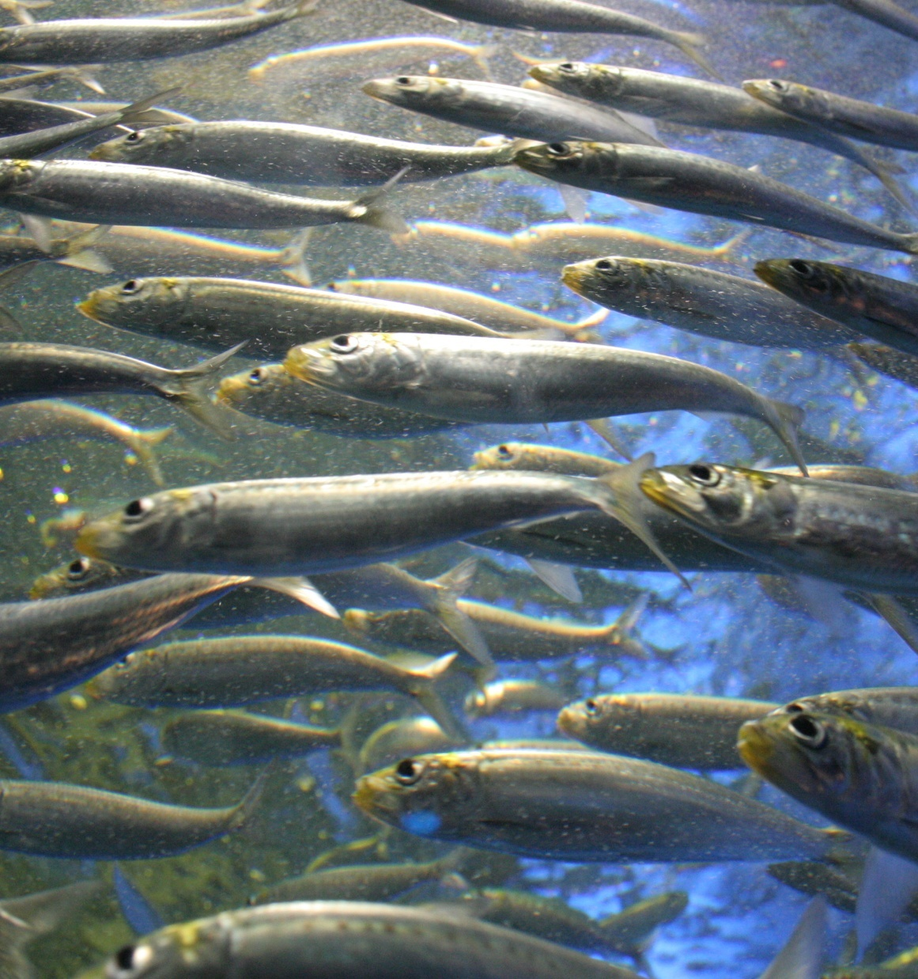
Flavours of time
partial order
for some pairs of
transitions T₁, T₂,
specify or verify
earlier(T₁,T₂) or later(T₁,T₂)
application:
specification or verification
e.g., manufacturing, control,
parallel calculations, …
http://www.sxc.hu/browse.phtml?f=download&id=443955
Notes:
3
In the film, this was illustrated by the example of cooking: some actions need to take place in proper order (don’t put pasta into the water unless it boils); other actions can take place either sooner or later than other actions.

Slide 4
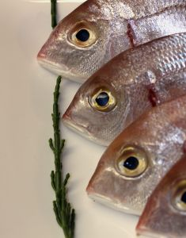
Flavours of time
total order
for all pairs of
transitions T₁, T₂,
specify or verify
earlier (T₁,T₂) or later(T₁,T₂)
application:
prediction or documentation
(logging) – e.g., engineering, time
tables, scheduling, games, …
http://www.sxc.hu/photo/1155437
Notes:
4
Total order waqs illustrated by reading a book, spending different amounts of time on each page, but visiting the pages in fixed order. Also the newspaper, the CD record and the long play record were examples of sysmtems to be described with totally ordered time.

Slide 5
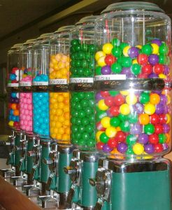
http://www.sxc.hu/photo/169851
Flavours of time
example of partial order:
specify coin operated
vending machine:
earlier(insertCoin,giveProduct)
earlier(makeChoice,giveProduct)
earlier(insertCoin,giveChange)
earlier(makeChoice,giveChange)
earlier(giveProduct,giveChange)
earlier(giveChange,giveProduct)
Notes:
5

Slide 6
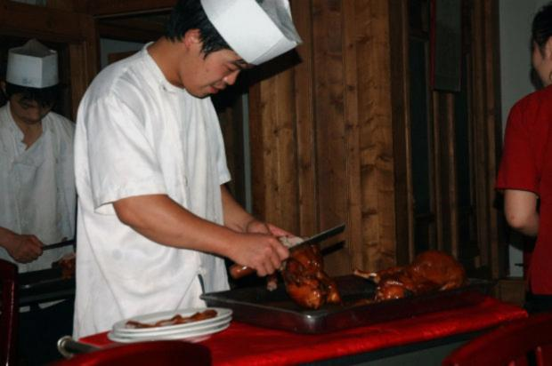
Flavours of time
partial order
cooking
calculating
manufacturing
....
http://www.morguefile.com/archive/display/135355
Notes:
6

Slide 7
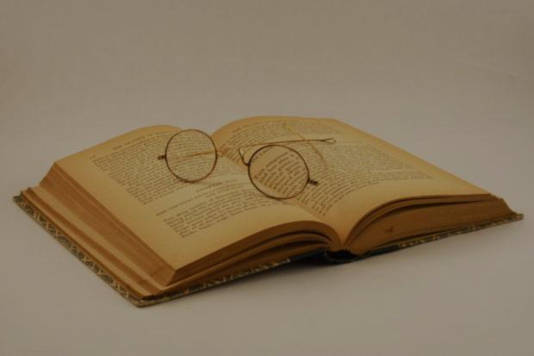
Flavours of time
total order + arbitrary intervals
reading
time table problems,
scheduling,
games,
communication protocols,
…
http://cdn.morguefile.com/imageData/public/files/c/chrisof4/preview/fldr_2008_11_08/file0001531630882.jpg
Notes:
7

Slide 8
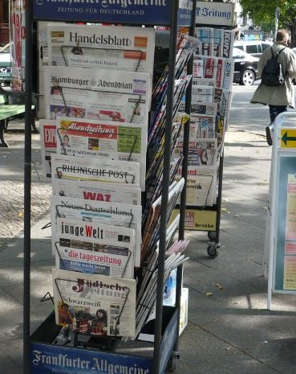
Flavours of time
total order + equal intervals
newspapers
compound interest,
discrete clocks
(pendulum,
tuning fork,
electronic clocks
...),
sampling,
...
http://cdn.morguefile.com/imageData/public/files/v/vicky53/preview/fldr_2008_11_28/file000106841344.jpg
Notes:
8

Slide 9
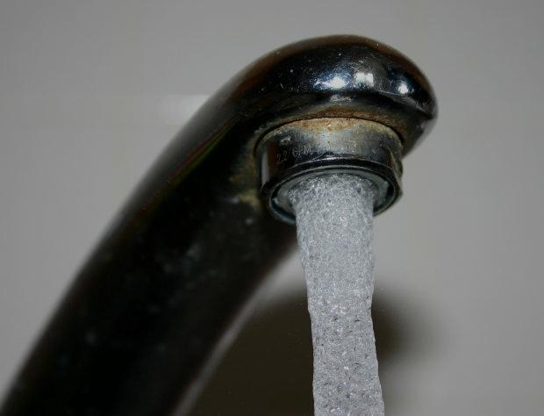
Flavours of time
total order + infinitesimal intervals
continuous physical processes
http://www.morguefile.com/archive/display/71806
Notes:
9

Slide 10
QUIZ
Flavours of time
(this is a question for musicians and music lovers)
In modeling various aspects of music, all four time models occur.
Explain!
total order + infinitesimal intervals
continuous physical processes
http://www.morguefile.com/archive/display/71806
Notes:
10

